Slide 1
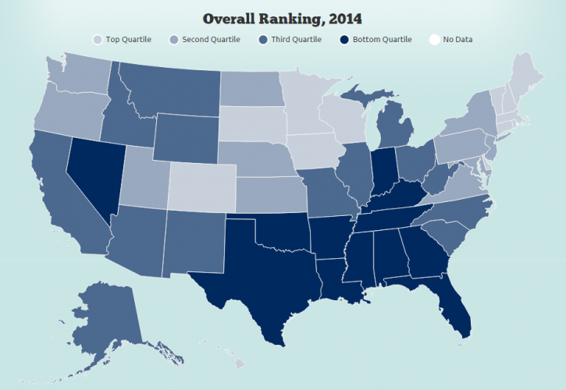
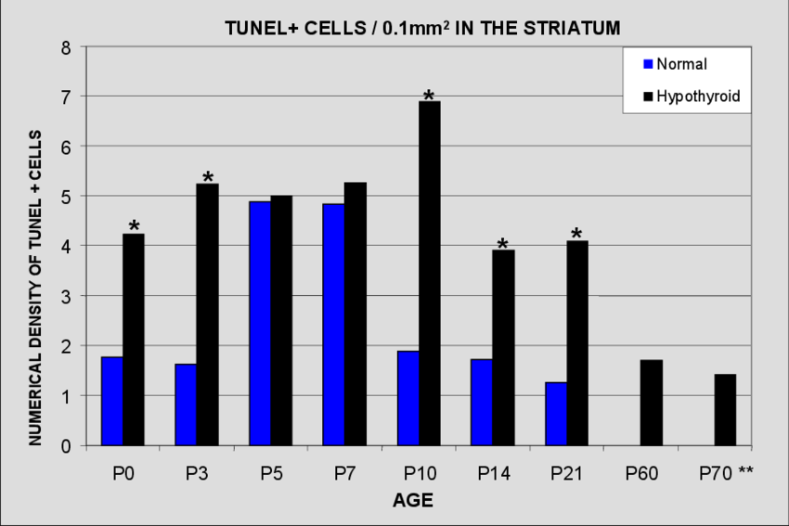
Dashboard
Traffic
COVID
1/2020
11/2020
Chart with Traffic and COVID Data by State

Slide 2
Viable architecture design
Python
JavaScript, HTML, CSS
Flask App
1. Read data from source
jsonify()
5. Expose data as JSON API
6. Read JSON API using JavaScript
7. Additional data preparation
8. Visualize and deploy into web dashboard
2. Preliminary preprocessing or analysis
4. Query database
3. Store in persistent database
Flask route navigates user to HTML UI, which triggers JavaScript
Notes:
Data url: https://www.google.com/imgres?imgurl=https%3A%2F%2Fcdn3.iconfinder.com%2Fdata%2Ficons%2Felastic-search-line%2F128%2FElastic_Search_-_Line-05-512.png&imgrefurl=https%3A%2F%2Fwww.iconfinder.com%2Ficons%2F4665701%2Fdata_data_source_database_elastic_search_search_data_icon&tbnid=dqN_fINWpMsvQM&vet=12ahUKEwi2xK-71sjnAhVGa6wKHXXYATEQMygAegUIARCBAg..i&docid=wfCWf4QNJdT3VM&w=512&h=512&q=data%20icon&ved=2ahUKEwi2xK-71sjnAhVGa6wKHXXYATEQMygAegUIARCBAg
Database: https://static.thenounproject.com/png/9658-200.png
Api: https://static.thenounproject.com/png/410844-200.png
Data preprocessing: https://cdn4.iconfinder.com/data/icons/internet-of-things-34/66/10-512.png
Javascript: https://cdn.iconscout.com/icon/free/png-256/javascript-20-555998.png
Data visualization: https://pngimage.net/wp-content/uploads/2018/06/graph-button-png-2.png

